Slide 1
(Some) Pitfalls
Of Agile Learning Design
Stephen Downes
December 3, 2015
Presented to: Online Educa Berlin

Slide 2
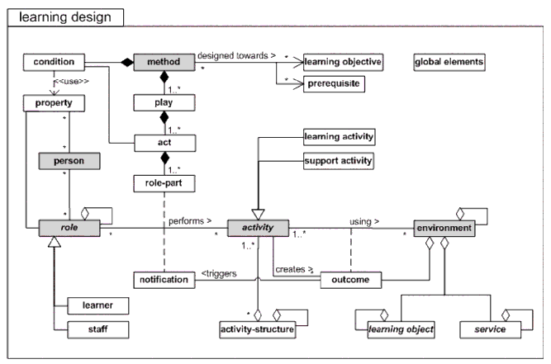
Learning Design….
https://www.imsglobal.org/learningdesign/ldv1p0/imsld_infov1p0.html

Slide 3
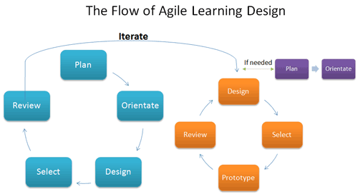
Agile Learning Design….

Slide 4

Scrum…
Process: Self-organizing development teams
Pitfall: Process takes time (storming, norming, performing)
  http://www.garfield.library.upenn.edu/classics1984/A1984TD25600001.pdf

Slide 5
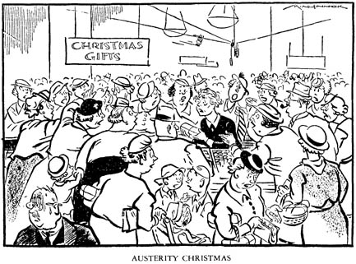
Pitfall: Very large self-organizing development teams
SCRUM

Slide 6
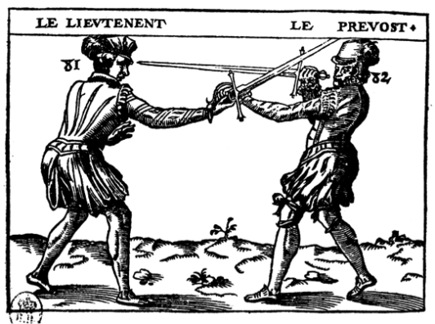
Pitfall: Competing self-organizing development teams
TEAM A
TEAM B

Slide 7
Pitfall: ‘specialist’ scrums
  “potentially shippable product increment”
  http://www.amazon.com/Agile-Project-Management-Microsoft-Professional/dp/073561993X
“I meet people who claim to be “doing Scrum” while executing “analysis sprints” or “design sprints” at the beginning, deferring integration and testing to the end, and holding different teams responsible for each phase…” http://scrumreferencecard.com/Obstacles_To_Enterprise_Agility_255033.pdf

Slide 8
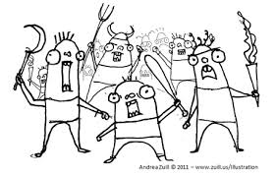
Process: Product Owner
Pitfall: who is the Product Owner?
http://www.agilesandiego.org/2013/01/31/mar-7th-mob-programming-a-whole-team-approach/

Slide 9

Pitfall: Conflicting Expertise
http://tisquirrel.me/tag/product-management/

Slide 10

Pitfall: Learning Objectives?
http://shah5thgrade.blogspot.de/

Slide 11

Stephen Downes
http://www.downes.ca

